Slide 1


Predictive Modelling for Customer Behaviour using Random Forest

Slide 2
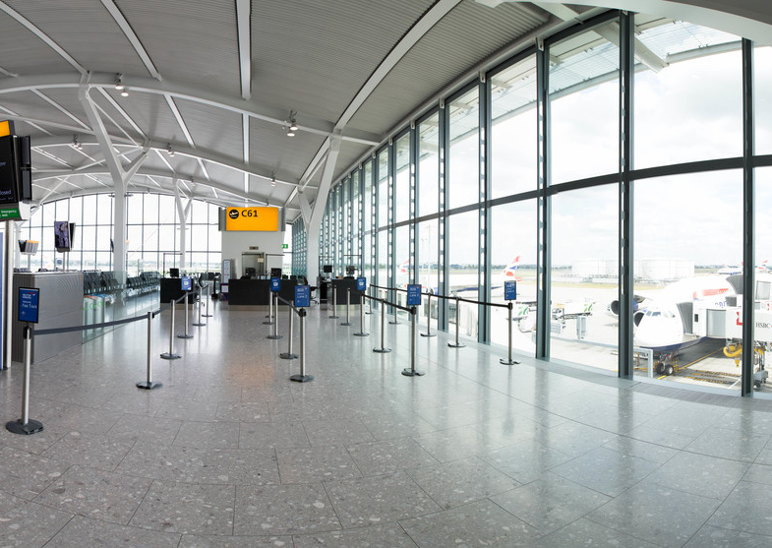
Customer Predictive Analysis using Random Forest
*SKF: Stratified K-Fold Cross Validation
*CV: Repeated Stratified K-Fold Cross Validation
Model | Accuracy | Precision | Recall | F1-score | SKF AUC | CV AUC
Baseline Random Forest | 0.84 | 0.35 | 0.08 | 0.13 | 0.687 | 0.688
Undersampling Balance Class | 0.63 | 0.24 | 0.69 | 0.35 | 0.702 | 0.702
Undersampling using NearMiss | 0.56 | 0.21 | 0.68 | 0.32 | 0.804 | 0.804
Oversampling Balance Class | 0.81 | 0.28 | 0.17 | 0.21 | 0.998 | 0.998
Oversampling using SMOTE | 0.79 | 0.25 | 0.21 | 0.23 | 0.947 | 0.947
Class-weighted balancing | 0.84 | 0.35 | 0.07 | 0.12 | 0.687 | 0.686
The class-weighted model performed similarly to the baseline model. The highest recall of about 0.69 was for the two undersampling models. Oversampling techniques significantly improved model performance. The SMOTE oversampling model achieved a mean ROC AUC of 0.95, while the model with balanced class oversampling reached a mean ROC AUC of 0.99 compared to the baseline model of 0.69. NearMiss undersampling (recall: 68%, precision: 21%, ROC AUC: 80.4%) improved upon the baseline model. These findings suggests that the model could benefit from further improvement.

Slide 3
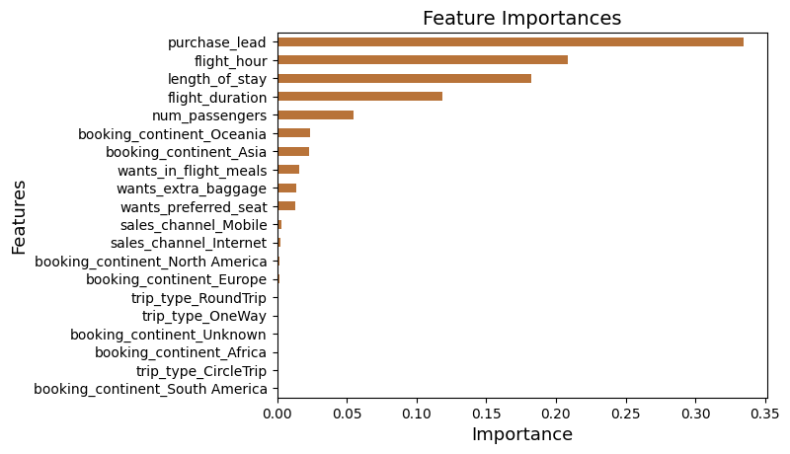
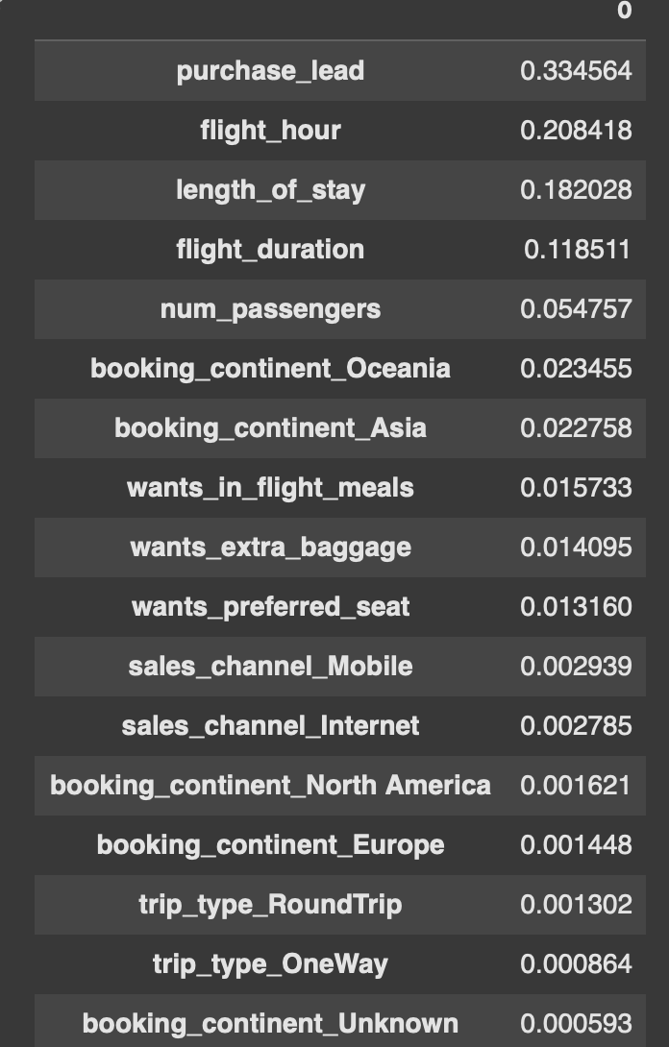
Customer Predictive Analysis – Feature importance
This finding suggests that bookings made closer to the departure date might have a stronger influence on the model's predictions compared to other factors we considered. Based on these findings, airlines can prioritise strategies to influence bookings made closer to departure. This could involve targeted marketing campaigns or dynamic pricing adjustments.
While purchase lead proved to be the most critical factor, other flight related features also played a significant role in the model. Flight hour, capturing the departure time, flight duration, representing the total travel time, and length of stay, indicating the trip duration, were all identified as important features. Interestingly, the customer's booking origin, sales channel, and trip type were not found to be as important as other factors. This finding suggests that factors like travel window ('purchase-lead') might be more influential than initial assumptions about traveler demographics or trip purposes.

